Slide 1
CSE 477: Introduction to Computer Security
Lecture – 9
Course Teacher: Dr. Md Sadek Ferdous
Assistant Professor, CSE, SUST
E-mail: ripul.bd@gmail.com

Slide 2
Outline
Elgamal Crypto System
Key Exchange
Hash Function
Digital Signature

Slide 3
Elgamal cryptosystem
The Elgamal cryptosystem, named after its inventor, Taher Elgamal, is a public-key cryptosystem that uses randomization
Enabling independent encryptions of the same plaintext to produce different ciphertexts
In the number system Z_{p}, all arithmetic is done modulo a prime number, p
A number, g in Z_{p}, is said to be a generator or primitive root modulo p if, for each positive integer k in Z_{p}, there is a unique integer i such that i = g^{k} mod p
For example,
3 is a primitive root modulo 7
3⁰ mod 7 = 1, 3¹ mod 7 = 3, 3² mod 7 = 2, 3³ mod 7 = 6, 3⁴ mod 7 = 4, 3⁵ mod 7 = 5, 3⁶ mod 7 = 1
Here, you get all the possible results: 1,3,2,6,4,5
3 is not a primitive root modulo 11
3⁰ mod 11 = 1, 3¹ mod 11 = 3, 3² mod 11 = 9, 3³ mod 11 = 5, 3⁴ mod 11 = 4, 3⁵ mod 11 = 1
You get 1, 3, 9, 5, 4 and this sequence repeats after 3⁵

Slide 4
Elgamal cryptosystem
It turns out that there are φ(φ(p)) = φ(p − 1) generators for Z_{p}
So we can test different numbers until we find one that is a generator
Once we have a generator g, we can efficiently compute x = g^{k} mod p, for any value k
Conversely, given x, g, and p, the problem of determining k such that x = g^{k} mod p is known as the discrete logarithm problem
Like factoring, the discrete logarithm problem is widely believed to be computationally hard
The security of the Elgamal cryptosystem depends on the difficulty of the discrete logarithm problem

Slide 5
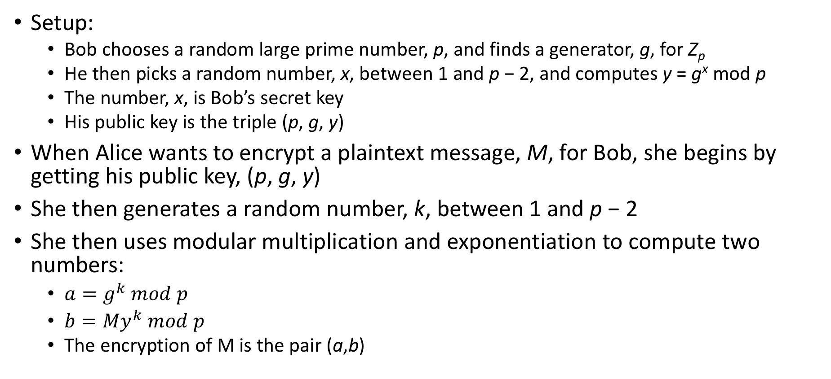
Elgamal cryptosystem
Setup:
Bob chooses a random large prime number, p, and finds a generator, g, for Z_{p}
He then picks a random number, x, between 1 and p − 2, and computes y = g^{x} mod p
The number, x, is Bob’s secret key
His public key is the triple (p, g, y)
When Alice wants to encrypt a plaintext message, M, for Bob, she begins by getting his public key, (p, g, y)
She then generates a random number, k, between 1 and p − 2
She then uses modular multiplication and exponentiation to compute two numbers:
$a=g^{k} mod p$
$b={My}^{k} mod p$
The encryption of M is the pair (a,b)

Slide 6
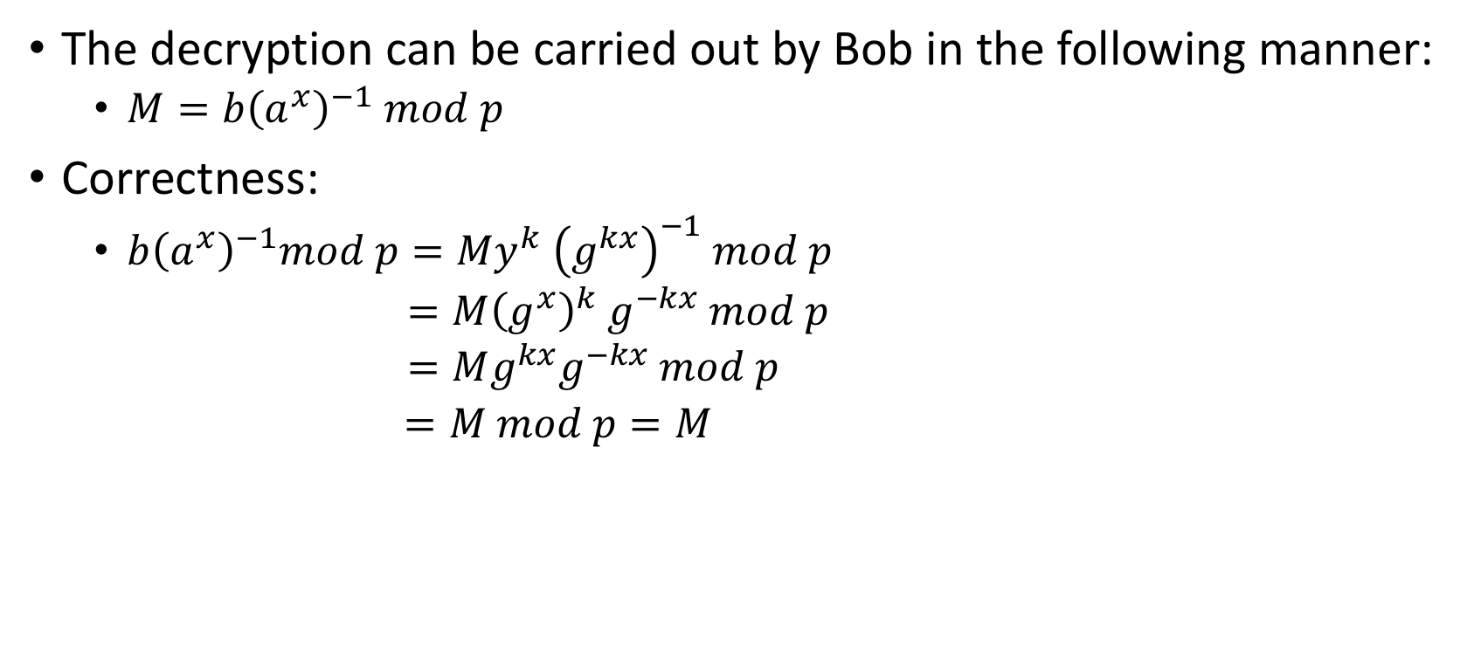
Elgamal cryptosystem
The decryption can be carried out by Bob in the following manner:
$M=b{\left(a^{x}\right)}^{−1} mod p$
Correctness:
$b{\left(a^{x}\right)}^{−1}mod p={My}^{k}$ ${\left(g^{kx}\right)}^{−1} mod p$
$=M{\left(g^{x}\right)}^{k} g^{−kx} mod p$
$=Mg^{kx}g^{−kx} mod p$
$=M mod p=M$

Slide 7
Elgamal cryptosystem
Note that Bob doesn’t need to know the random value, k, to decrypt a message that was encrypted using this value
And Alice didn’t need to know Bob’s secret key to encrypt the message for him in the first place
Instead, Alice got g^{x}, as y, from Bob’s public key, and Bob got g^{k}, as a, from Alice’s ciphertext
Alice raised y to the power k and Bob raised a to the power x, and in so doing they implicitly computed a type of one- time shared key, g^{xk}
which Alice used for encryption and Bob used for decryption

Slide 8
Elgamal cryptosystem
The security of this scheme is based on the fact that, without knowing x, it would be very difficult for an eavesdropper to decrypt the ciphertext, (a, b)
Since everyone knows y = g^{x} mod p, from Bob’s public key, the security of this scheme is therefore related to the difficulty of solving the discrete logarithm problem
That is, Elgamal could be broken by an eavesdropper finding the secret key, x
This can be only done by solving the discrete logarithm problem which is believed to computationally hard
Note that an Elgamal encryption is dependent on the choice of the random number, k
Different k should be chosen for different message encryption
If k is reused she would be leaking information much like the one-time pad would leak information if we were to reuse a pad

Slide 9
Key exchange
The use of a symmetric cryptosystem requires that Alice and Bob agree on a secret key before they can send encrypted messages to each other
Accomplish it by the one-time use of a private communication channel, such as an in-person meeting in a private room, or mailing in tamper-proof containers
A key exchange protocol, which is also called key agreement protocol, is a cryptographic approach
to establish a shared secret key by communicating solely over an insecure channel, without any previous private communication
Intuitively, the existence of a key exchange protocol appears unlikely
as the adversary can arbitrarily disrupt the communication between Alice and Bob
Indeed, it can be shown that no key exchange protocol exists if the adversary can actively modify messages sent over the insecure channel
Nevertheless, key exchange can be successfully accomplished if the adversary is limited to only passive eavesdropping on messages

Slide 10
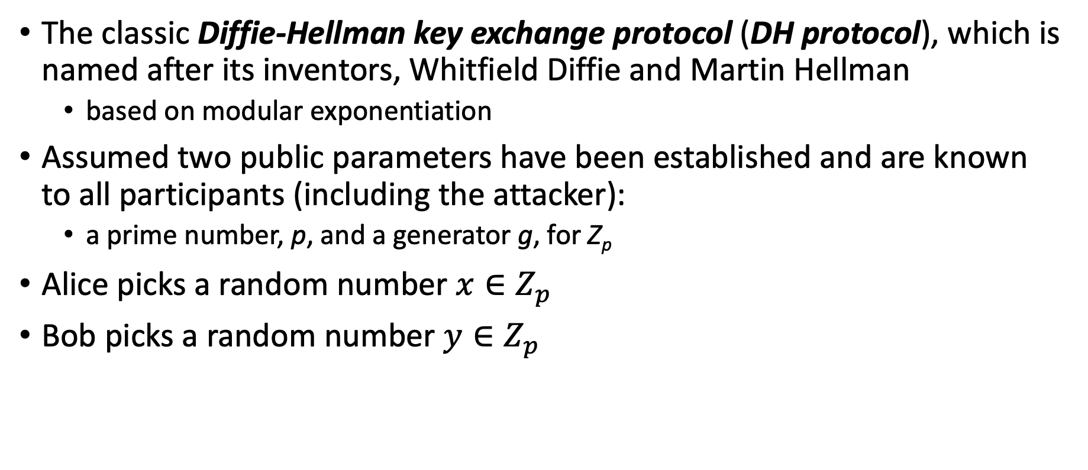
Diffie-Hellman key exchange protocol (DH protocol)
The classic Diffie-Hellman key exchange protocol (DH protocol), which is named after its inventors, Whitfield Diffie and Martin Hellman
based on modular exponentiation
Assumed two public parameters have been established and are known to all participants (including the attacker):
a prime number, p, and a generator g, for Z_{p}
Alice picks a random number $x∈Z_{p}$
Bob picks a random number $y∈Z_{p}$

Slide 11
Diffie-Hellman key exchange protocol (DH protocol)
Picks x in Z_{p}
Picks y in Z_{p}
Alice
Bob
X = g^{x} mod p
Y = g^{y} mod p
K₁ = Y^{x} mod p
K₂ = X^{y} mod p

Slide 12
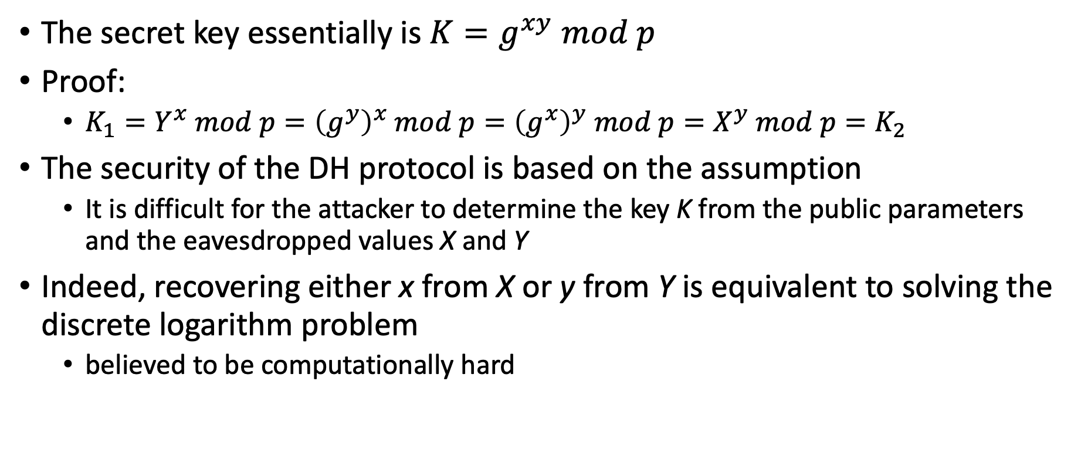
Diffie-Hellman key exchange protocol (DH protocol)
The secret key essentially is $K=g^{xy} mod p$
Proof:
$K_{1}=Y^{x} mod p={\left(g^{y}\right)}^{x} mod p={\left(g^{x}\right)}^{y} mod p=X^{y} mod p=K_{2}$
The security of the DH protocol is based on the assumption
It is difficult for the attacker to determine the key K from the public parameters and the eavesdropped values X and Y
Indeed, recovering either x from X or y from Y is equivalent to solving the discrete logarithm problem
believed to be computationally hard

Slide 13
Diffie-Hellman key exchange protocol (DH protocol)
Alice and Bob agree on p = 23 and g = 5
Alice chooses x = 6 and sends 5⁶ mod 23 = 8 as X
Bob chooses y = 15 and sends 5¹⁵ mod 23 = 19 as Y
Alice computes K₁ = 19⁶ mod 23 = 2
Bob computes 8¹⁵ mod 23 = 2
2 is their shared secret!
Clearly, much larger values of x, y, and p are required

Slide 14
Attack on DH protocol
Even though it is secure against a passive attacker, the DH protocol is vulnerable to a man-in-the-middle attack if the attacker can intercept and modify the messages exchanged by Alice and Bob
Picks x in Z_{p}
Picks numbers s and t in Z_{p}
Picks y in Z_{p}
Alice
Mallory
Bob
X = g^{x} mod p
T = g^{t} mod p
Y = g^{y} mod p
S = g^{s} mod p
K₁ = g^{xs} mod p
K₂ = g^{yt} mod p
Encrypt with K₁
Decrypt with K₁
Encrypt with K₂
Decrypt with K₂

Slide 15
Cryptographic Hash Functions
A cryptographic hash function produces a compressed digest of a message with three properties: deterministic, one-way, and collision-resistant
Deterministic property will ensure that a fixed input will produce a same output
The hash value should be significantly smaller than a typical message
For example, the commonly used standard hash function SHA-256 produces hash values with 256 bits
The digest will be such that changing one bit of input should potentially impact every bit of output
A hash function utilises several of the techniques employed in symmetric encryption, including substitution, permutation, exclusive-or, and iteration, in a way that provides the required diffusion

Slide 16
Hash Function: one way
That is, given a message, M, it should be easy to compute a hash value, H(M), from that message
However, given only a value, x, it should be difficult to find a message, M, such that x = H(M)

Slide 17
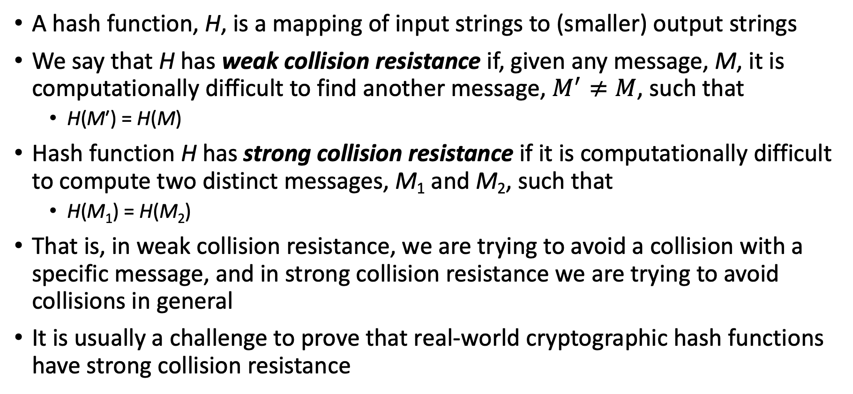
Hash Function: collision resistance
A hash function, H, is a mapping of input strings to (smaller) output strings
We say that H has weak collision resistance if, given any message, M, it is computationally difficult to find another message, $M^{′}≠M$, such that
H(M′) = H(M)
Hash function H has strong collision resistance if it is computationally difficult to compute two distinct messages, M₁ and M₂, such that
H(M₁) = H(M₂)
That is, in weak collision resistance, we are trying to avoid a collision with a specific message, and in strong collision resistance we are trying to avoid collisions in general
It is usually a challenge to prove that real-world cryptographic hash functions have strong collision resistance

Slide 18
Hash Function: construction
A hash function utilises a building block called cryptographic compression function C(X, Y)
C takes as input two strings, X and Y, where X has fixed length m and Y has fixed length n
produces a hash value of length n
Given a message M, we divide M into multiple blocks, M₁, M₂, . . ., M_{k}, each of length m
The last block is padded in an unambiguous way with additional bits to make it of length m

Slide 19
Hash Function: construction
For block M_{1,} input M₁ with a fixed string v of length n, known as the initialization vector, to C
Denote, d₁ = C(M₁,v)
Next, we apply the compression function to block M₂ and d₁
resulting in d₂ = C(M₂, d₁)
These go on for all k blocks
Final hash value, H = d_{k}
Known as the Merkle-Damgård construction
Ralph Merkle & Ivan Damgård

Slide 20
Hash Function: practical implementation
The currently recommended hash function for cryptographic applications are the SHA-256 and SHA-512 standardized by NIST
SHA stands for “Secure Hash Algorithm”
The numeric suffix refers to the length of the hash value
Utilises the Merkle-Damgård construction
SHA-256 employs a compression function with inputs of:
m = 512 bits and n = 256 bits and produces hash values of n = 256 bits
For SHA-512: m = 1,024 and n = 512
MD5 (Message Digest 5) hash function is still widely used in legacy applications
However, it is considered insecure as several attacks against it have been demonstrated
For example, one can generate different PDF files or executable files with the same MD5 hash, a major vulnerability!

Slide 21
Hash Function: birthday attack
The main way that cryptographic hash functions are attacked with is by compromising their collision resistance
Sometimes this is done by careful cryptanalysis of the algorithms used to perform cryptographic hashing
But it can also be done by using a brute-force technique known as a birthday attack
This attack is based on a nonintuitive statistical phenomenon that states that as soon as there are more than 23 people in a room, there is better than a 50-50 chance that two of the people have the same birthday
If there are more than 60 people in a room, it is almost certain that two of them share a birthday
Here, sharing birthday represents finding a collision

Slide 22
Hash Function: birthday attack
The problem is to compute the approximate probability that in a group of n people, at least two have the same birthday
The goal is to compute P(A)
the probability that at least two people in the room have the same birthday
However, it is simpler to calculate P(A’)
the probability that no two people in the room have the same birthday
Because A and A' are the only two possibilities and are also mutually exclusive, P(A) = 1 − P(A')
When events are independent of each other, the probability of all of the events occurring is equal to a product of the probabilities of each of the events occurring
P(A') can be described as 23 independent events
P(A’) = P(1) × P(2) × P(3) × ... × P(23)

Slide 23
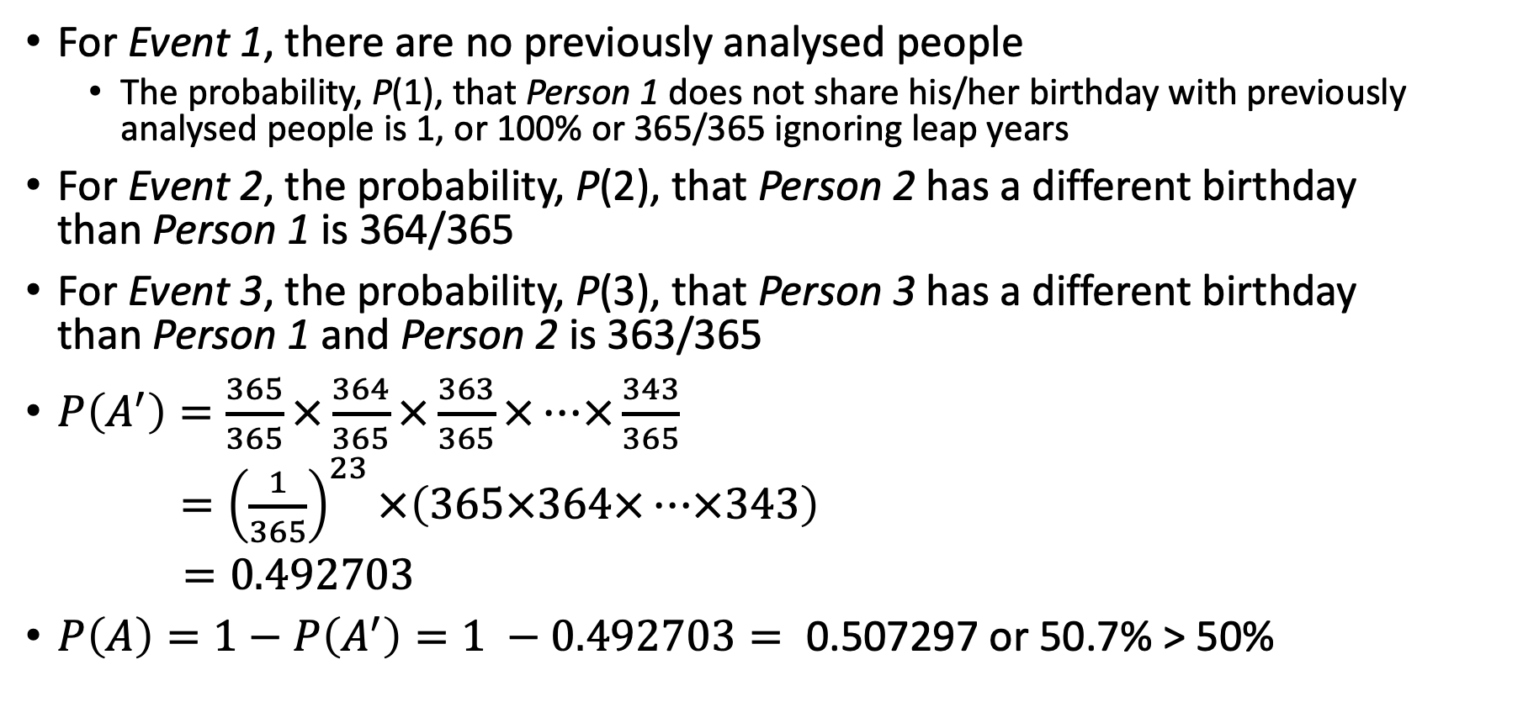
Hash Function: birthday attack
For Event 1, there are no previously analysed people
The probability, P(1), that Person 1 does not share his/her birthday with previously analysed people is 1, or 100% or 365/365 ignoring leap years
For Event 2, the probability, P(2), that Person 2 has a different birthday than Person 1 is 364/365
For Event 3, the probability, P(3), that Person 3 has a different birthday than Person 1 and Person 2 is 363/365
$P\left(A^{′}\right)=\frac{365}{365}×\frac{364}{365}×\frac{363}{365}×…×\frac{343}{365}$
$={\left(\frac{1}{365}\right)}^{23}×\left(365×364×…×343\right)$
$=0.492703$
$P\left(A\right)=1−P\left(A^{′}\right)=1 −0.492703=\text{ 0.507297}$ or 50.7% > 50%

Slide 24
Digital signature
A digital signature is a way for an entity to demonstrate the authenticity of a message by binding its identity with that message
Alice uses her private key with a signature algorithm to produce a digital signature, S_{Alice}(M), for a message, M
Given Alice’s public key, the message, M, and Alice’s signature, S_{Alice}(M)
Bob verifies Alice’s signature on M

Slide 25
Digital signature: properties
Three important properties that we would like to have for a digital- signature scheme are the following:
Nonforgeability: It should be difficult for an attacker, Eve, to forge a signature, S_{Alice}(M), for a message, M, as if it is coming from Alice
Nonmutability: It should be difficult for an attacker, Eve, to take a signature, S_{Alice}(M), for a message, M, and convert S_{Alice}(M) into a valid signature on a different message, N
Non-repudiation: If a digital-signature scheme achieves these two properties, then it actually achieves nonrepudiation
It should be difficult for Alice to claim she didn’t sign a document, M, once she has produced a digital signature, S_{Alice}(M), for that document

Slide 26
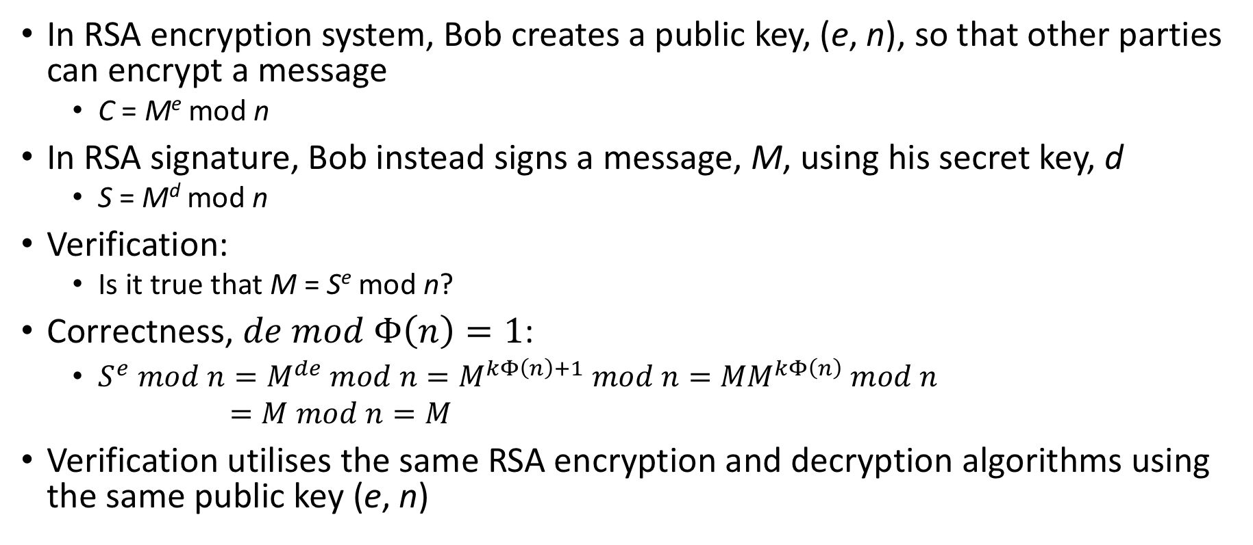
RSA signature
In RSA encryption system, Bob creates a public key, (e, n), so that other parties can encrypt a message
C = Me mod n
In RSA signature, Bob instead signs a message, M, using his secret key, d
S = M^{d} mod n
Verification:
Is it true that M = S^{e} mod n?
Correctness, $de mod Φ\left(n\right)=1$:
$S^{e} mod n=M^{de} mod n=M^{kΦ\left(n\right)+1} mod n={MM}^{kΦ\left(n\right)} mod n$
$=M mod n=M$
Verification utilises the same RSA encryption and decryption algorithms using the same public key (e, n)

Slide 27
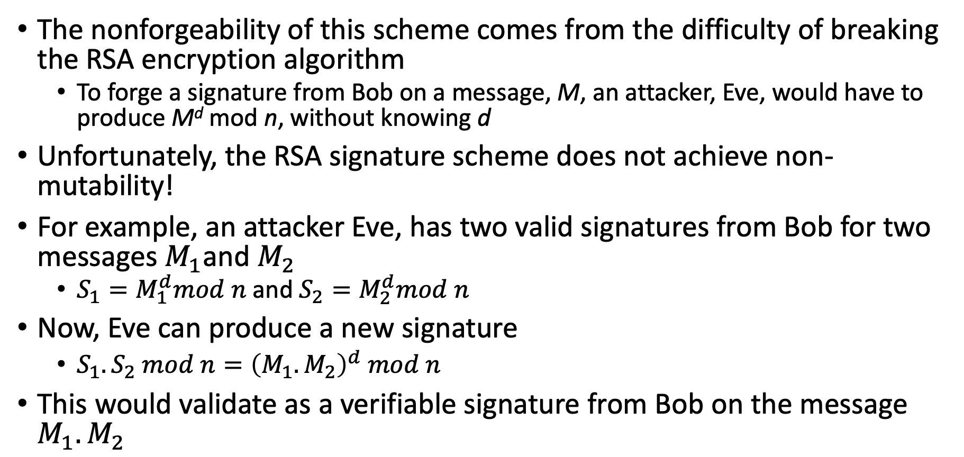
RSA signature: security
The nonforgeability of this scheme comes from the difficulty of breaking the RSA encryption algorithm
To forge a signature from Bob on a message, M, an attacker, Eve, would have to produce M^{d} mod n, without knowing d
Unfortunately, the RSA signature scheme does not achieve non- mutability!
For example, an attacker Eve, has two valid signatures from Bob for two messages $M_{1}$and $M_{2}$
$S_{1}=M_{1}^{d}mod n$ and $S_{2}=M_{2}^{d}mod n$
Now, Eve can produce a new signature
$S_{1}.S_{2} mod n={\left(M_{1}.M_{2}\right)}^{d} mod n$
This would validate as a verifiable signature from Bob on the message $M_{1}.M_{2}$

Slide 28
Hash function + Digital signature
For practical purposes, the above descriptions of the RSA digital-signature schemes are not what one would use in practice
Firstly, the scheme is inefficient if the message, M, being signed is very long
For instance, RSA signature creation involves an encryption of the message, M, using a private key
Secondly, one can construct valid RSA signatures on combined messages from existing RSA signatures as shown before
For these reasons, real-world digital-signature schemes are usually applied to cryptographic hashes of messages, not to actual messages
This approach significantly reduces the mutability risk for RSA signatures
For instance, since it is extremely unlikely that the product of two hash values, H(M) and H(N), would itself be equal to the hash of the product message, M · N
Moreover, signing a hash value is more efficient than signing a full message

Slide 29

The lecture slides can be found in the following location!

